Slide 1




4
Power BI
Manager Guide
Prepared By :
Said Fawzy
Manager of Information Center
Tendering Department
Arab Contractors

Slide 2

Chapter 4: Visuals

Slide 3
01
What are visualizations?
02
Bar and Column Charts
Module Contents
Pie and donut charts
03
Line Chart
04

Slide 4
05
Area Chart
06
Table Visualization
Module Contents
Combo Chart
07
Treemaps
08

Slide 5
05
Funnel charts
06
Ribbon Charts
Module Contents
Waterfall Charts
07
Scatter charts
08

Slide 6
05
Card, Multi-row Card, Gauges, KPI
06
Interactive Report
Module Contents
Cross-filter and cross-highlight
07
Buttons
08

Slide 7




What are visualizations?

Slide 8
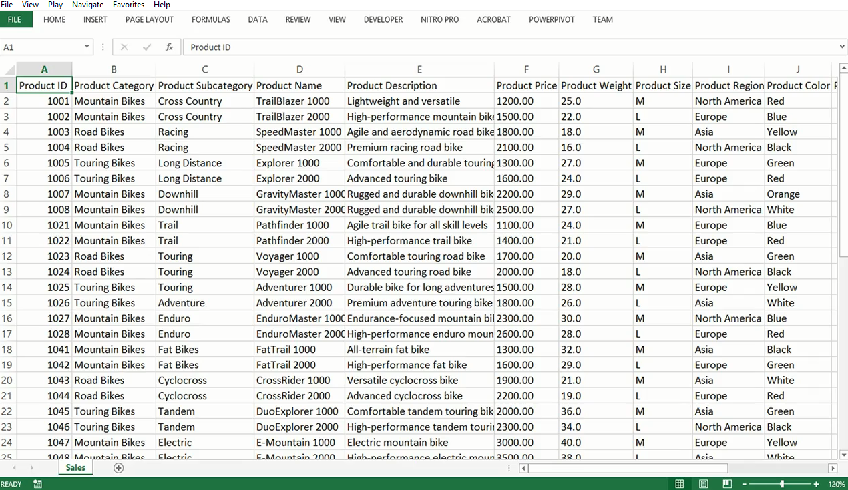
Data Comes in a Complex way and hard to digest

Slide 9
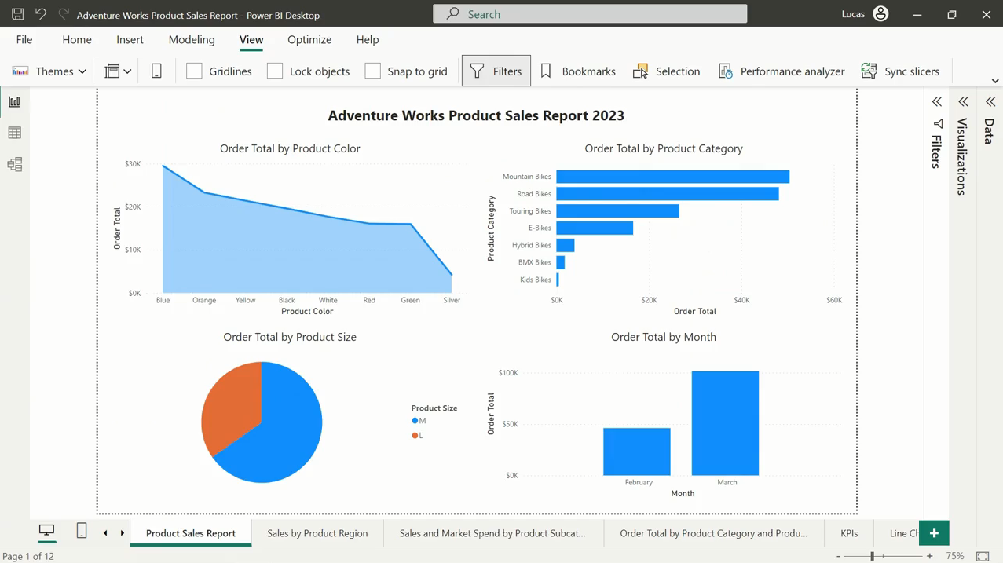
You can visualize data
to transform the data into
a compelling, interactive, and easily digestible format

Slide 10
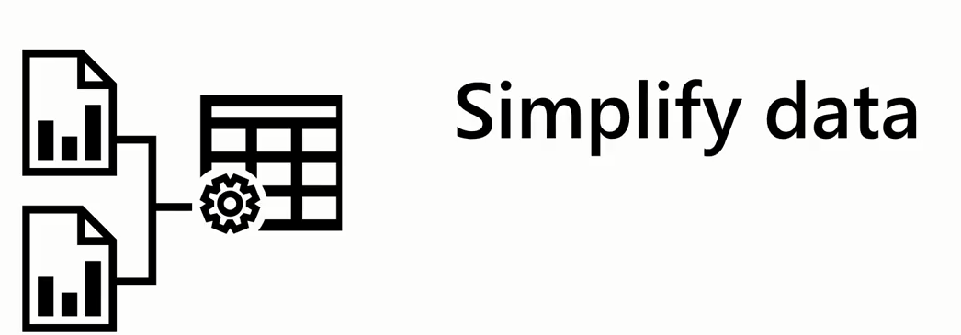

How data visualization can enhance business intelligence

Slide 11
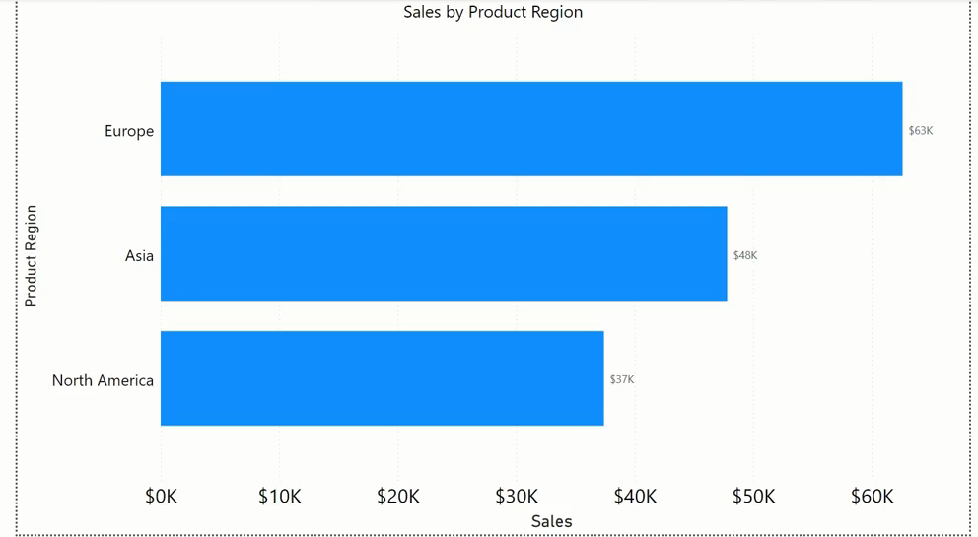
How data visualization can enhance business intelligence

Slide 12
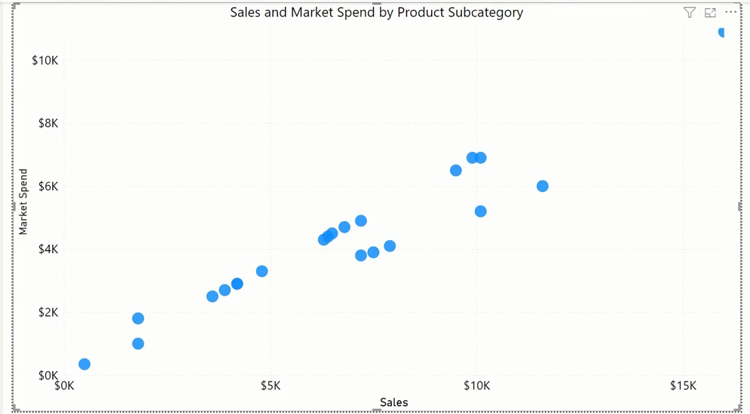
How data visualization can enhance business intelligence

Slide 13
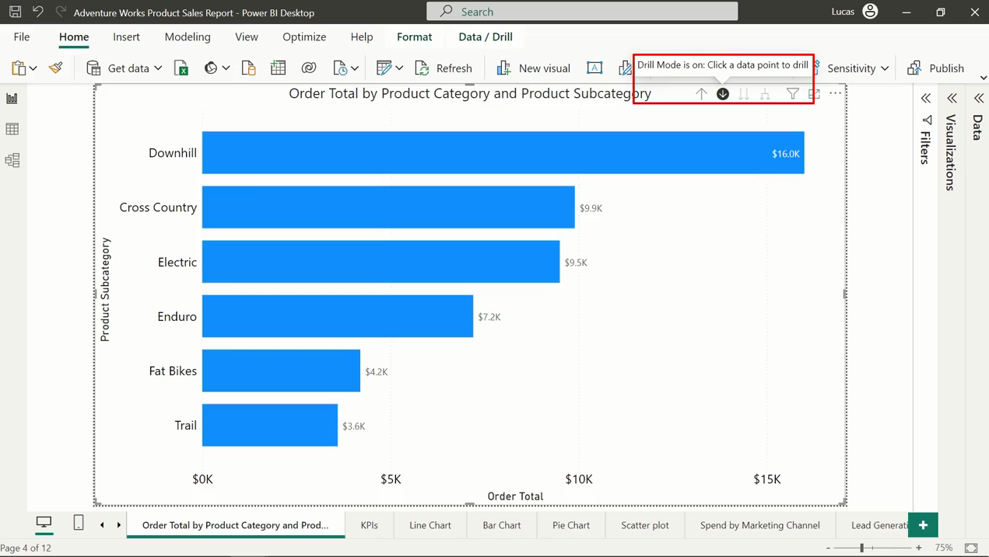
How data visualization can enhance business intelligence
Drill down data

Slide 14


How data visualization can enhance business intelligence

Slide 15

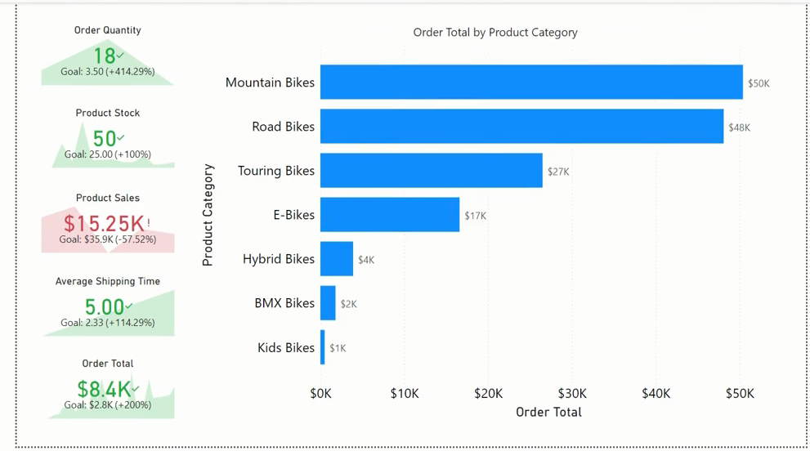
How data visualization can enhance business intelligence

Slide 16
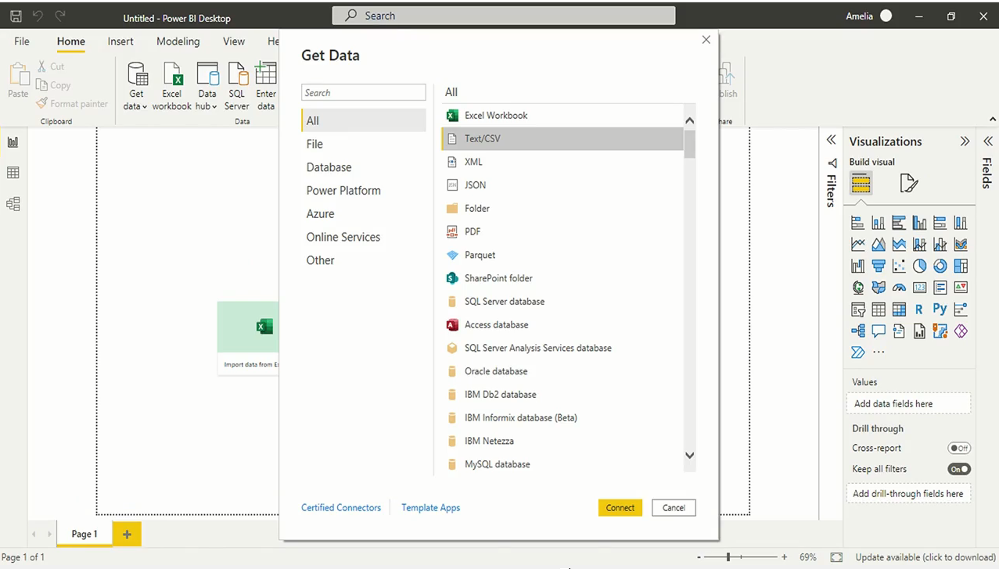
Creating visualizations in Power BI
Starts with connecting to data

Slide 17
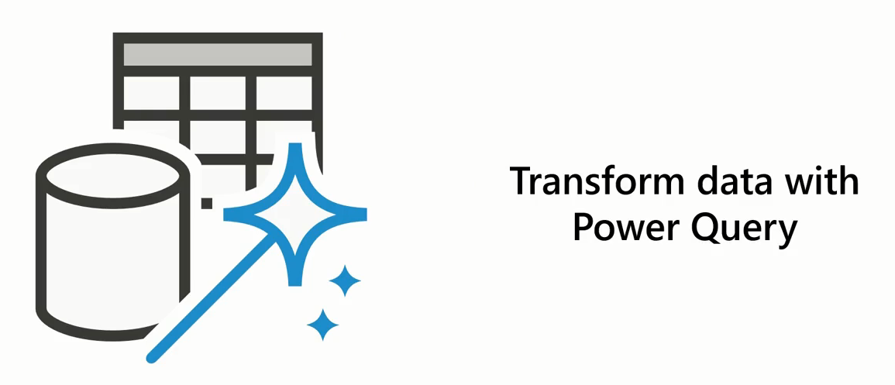
Creating visualizations in Power BI

Slide 18
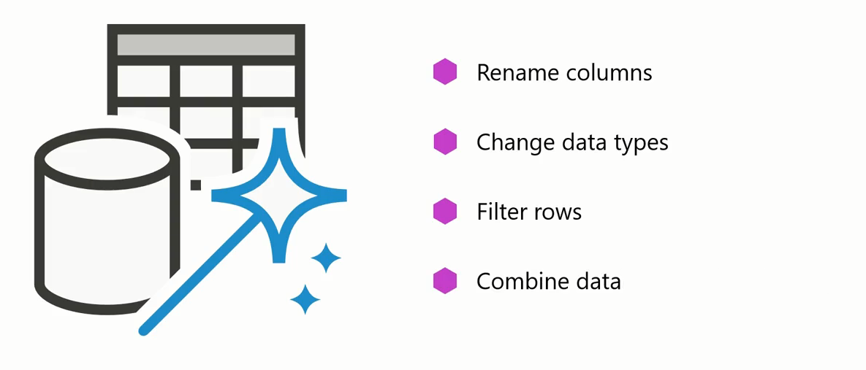
Creating visualizations in Power BI

Slide 19
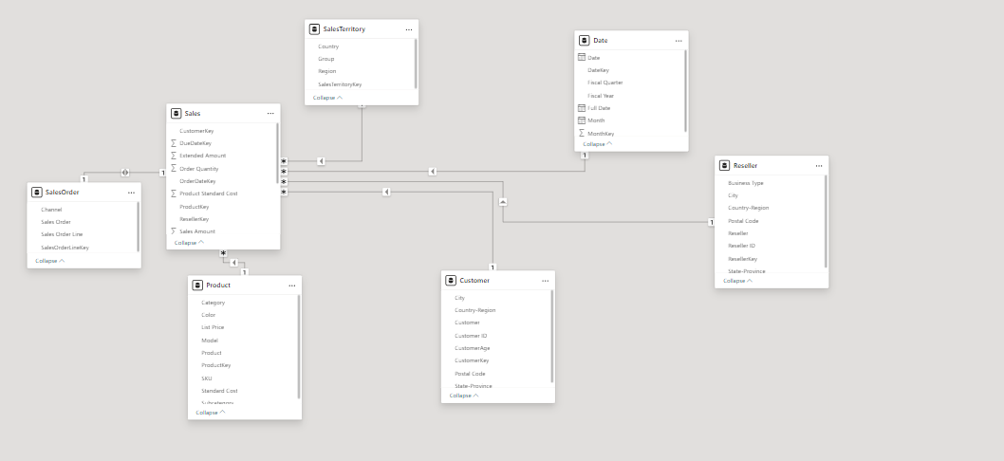
Creating visualizations in Power BI
Data Modeling and Using DAX

Slide 20
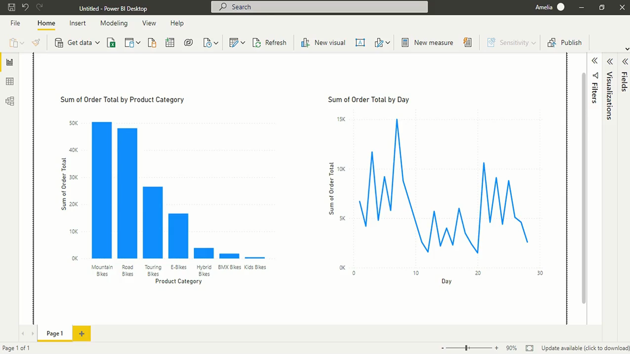
Creating visualizations in Power BI
Visualizing Data

Slide 21

Creating visualizations in Power BI

Slide 22
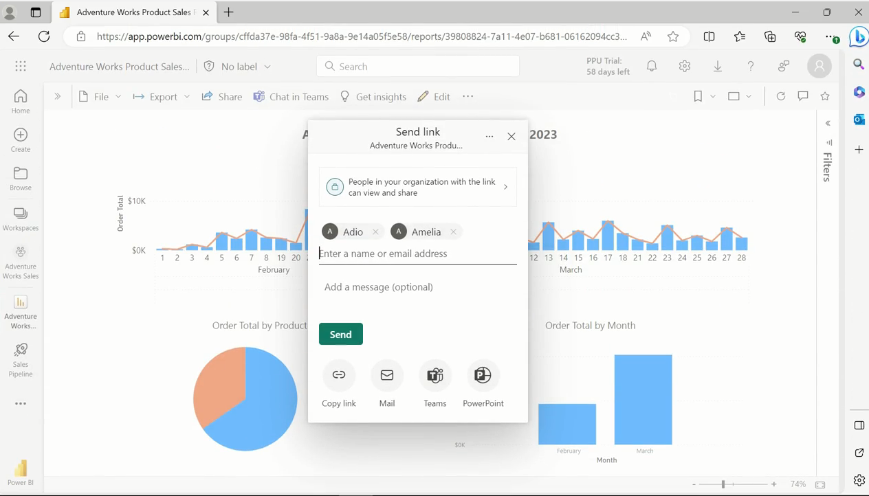
Creating visualizations in Power BI
Publish and share report

Slide 23
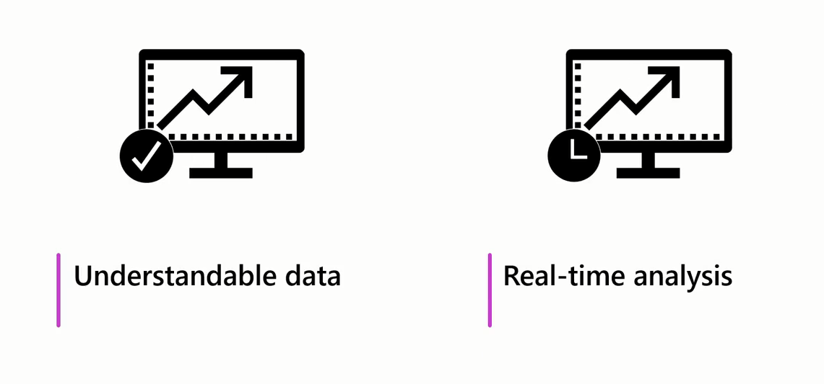
Creating visualizations in Power BI

Slide 24
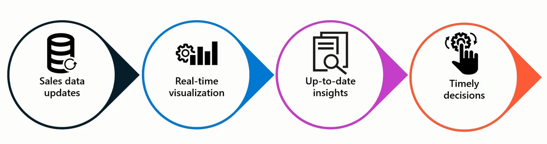

Creating visualizations in Power BI

Slide 25

Choose The Right Visual

Slide 26
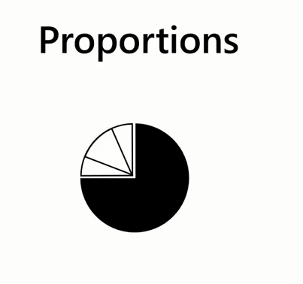
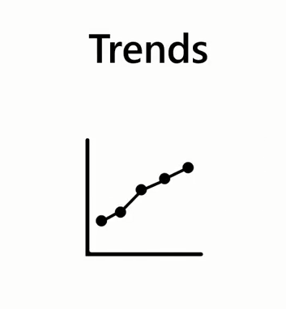
Choose The Right Visual

Slide 27

Choose The Right Visual

Slide 28
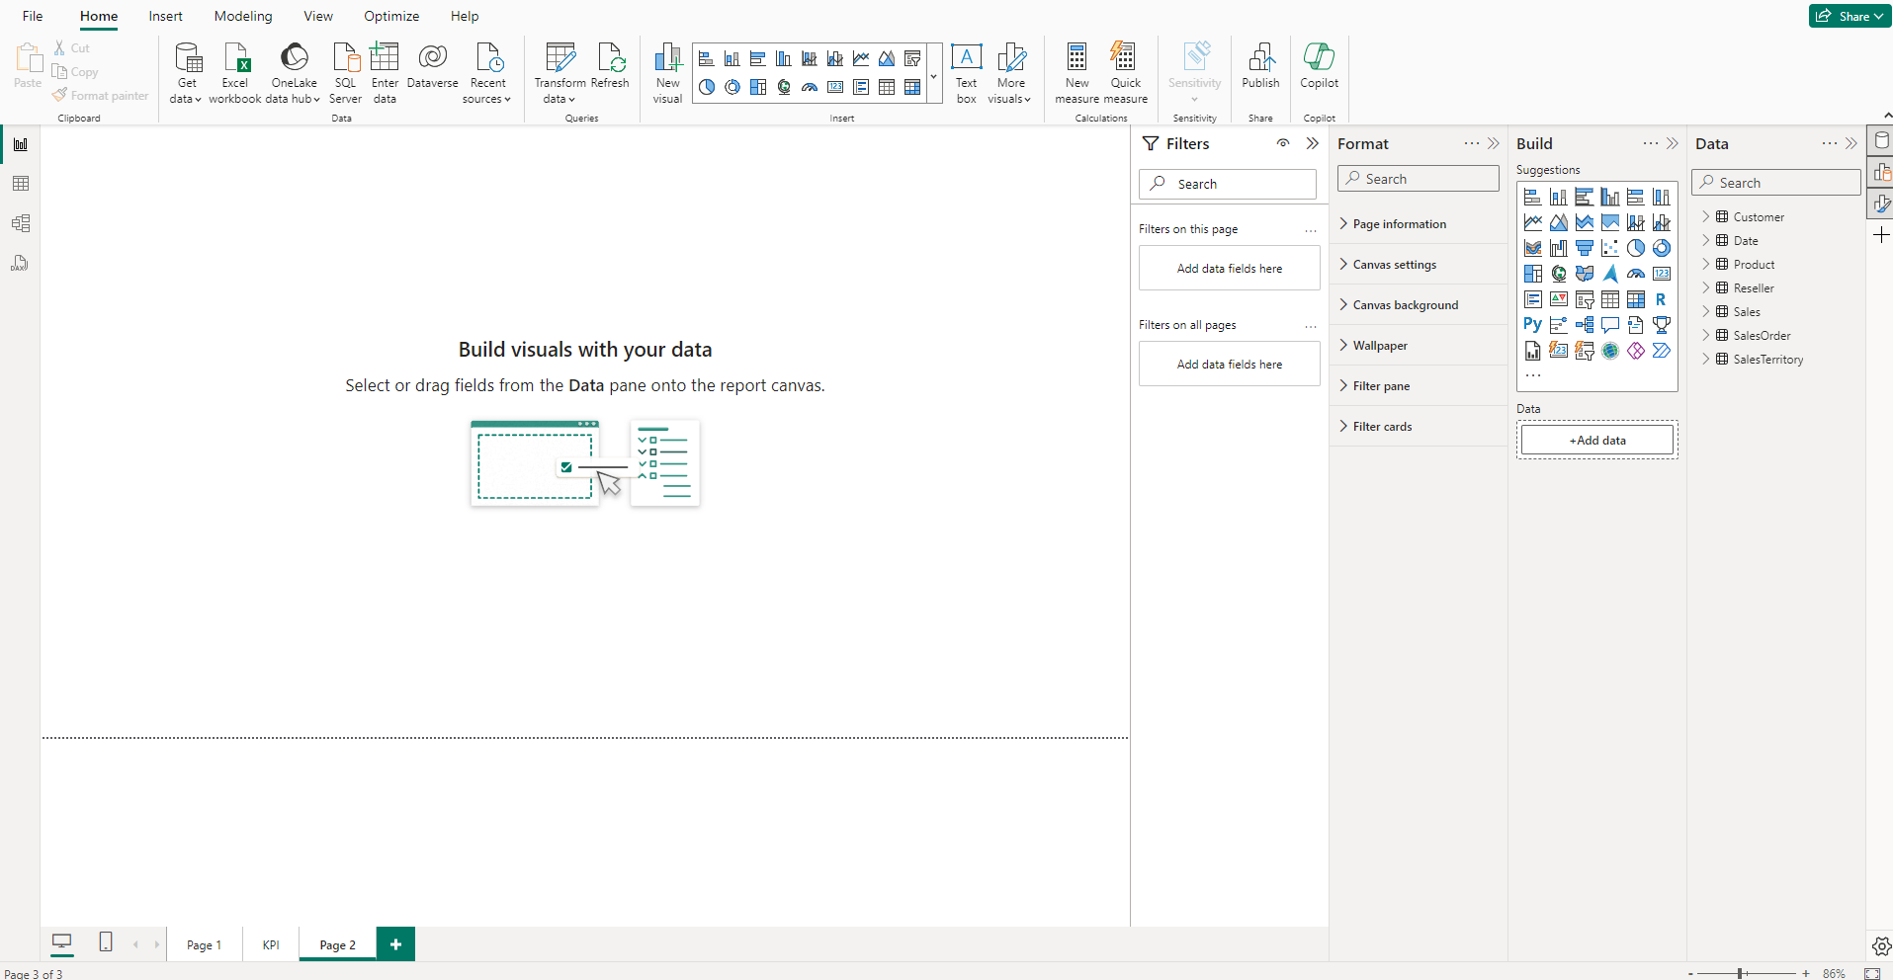
Report Editor
This is where you'll spend most of your time converting raw data into meaningful visual stories.

Slide 29
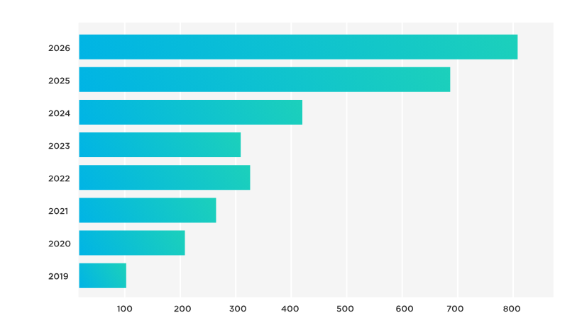
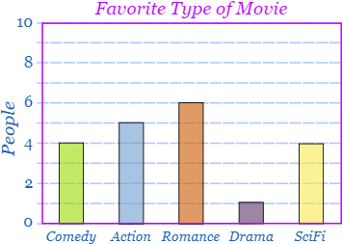
Bar and Column Charts
Bar and column charts are popular types of visualizations to display data in a clear and organized way.
They are beneficial for showcasing categorical data or data that can be organized into distinct groups.

Slide 30
Bar and Column Charts
Bar charts display data horizontally, whereas column charts display data vertically.

Slide 31
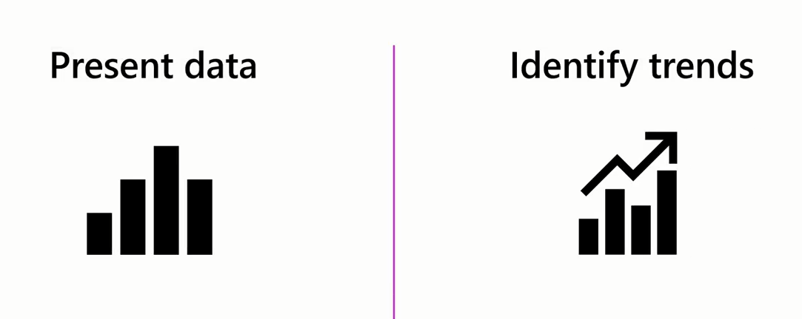
Bar and Column Charts
The simplicity and intuitive nature of bar and column charts make them effective tools for presenting data and identifying patterns or trends over time.

Slide 32
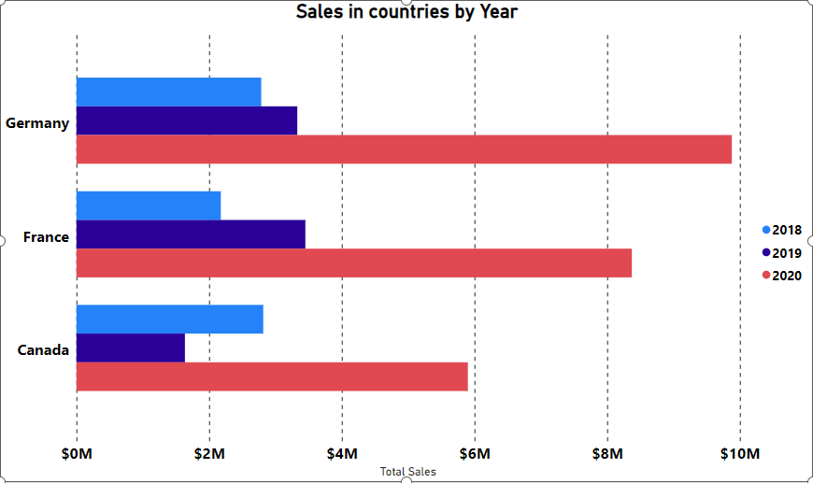
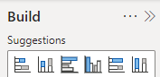
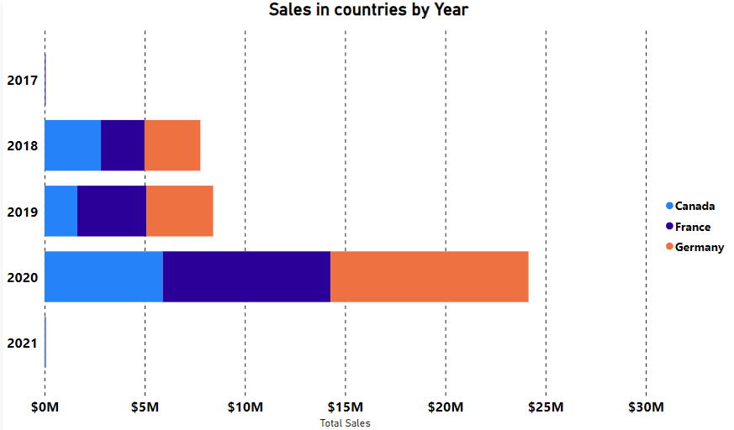
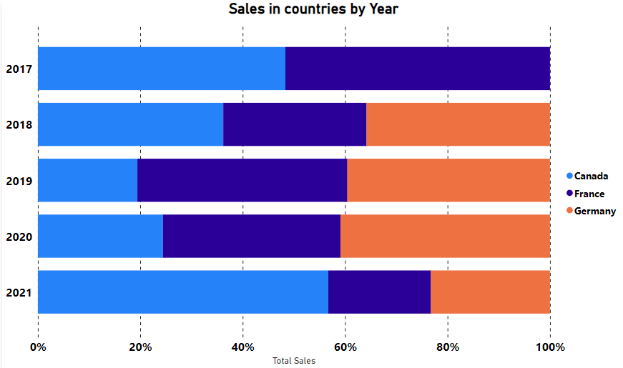
6 Types of Bar and Column Charts
Clustered
Stacked
100% Stacked

Slide 33
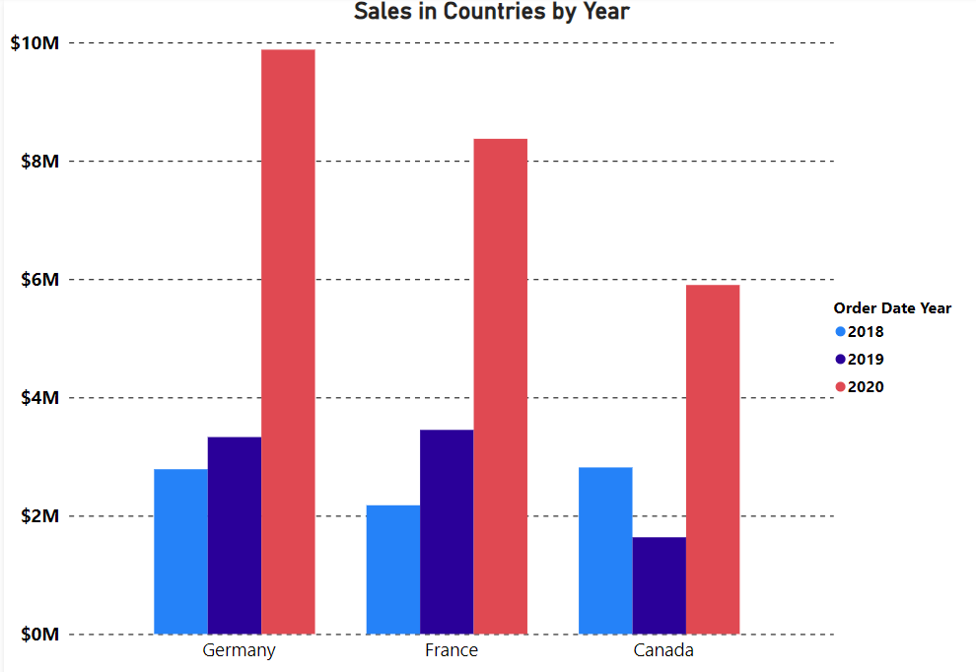
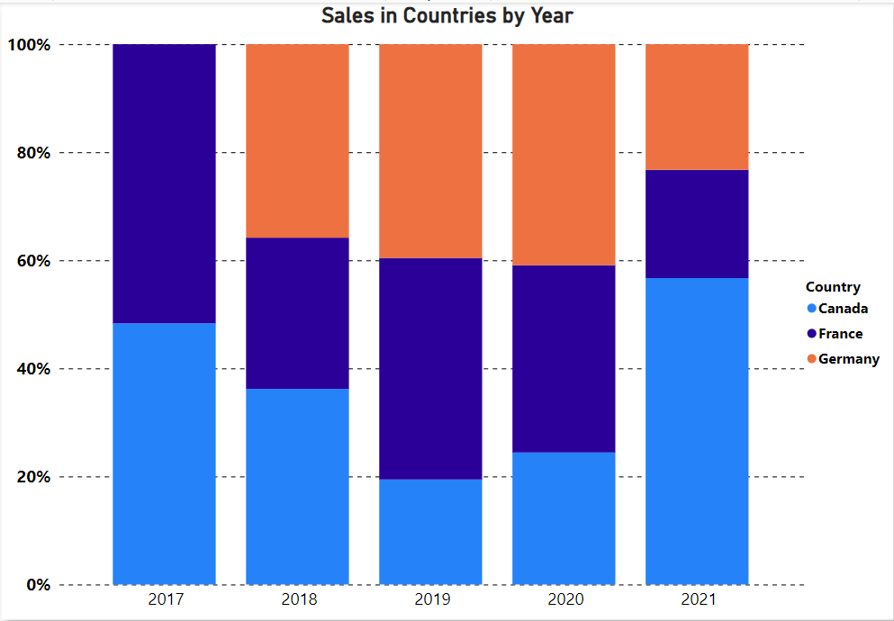
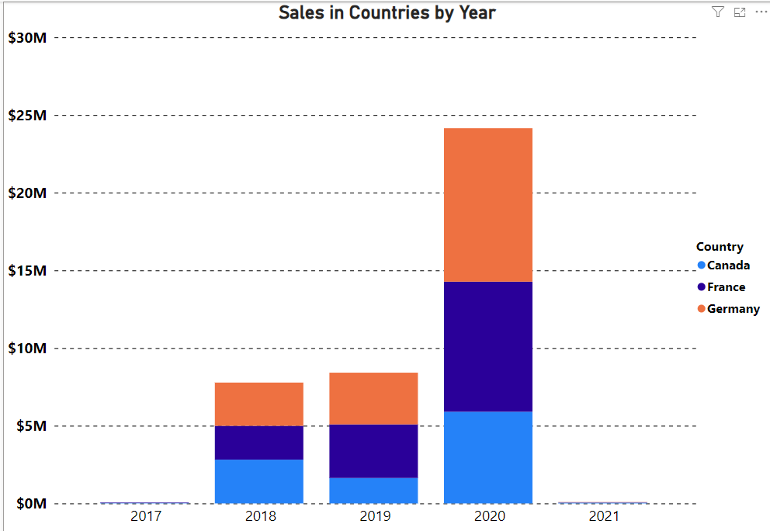
6 Types of Bar and Column Charts
Clustered
Stacked
100% Stacked

Slide 34
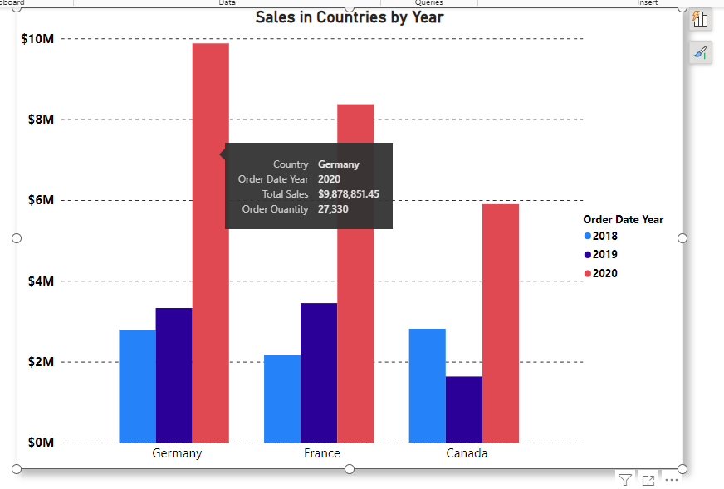
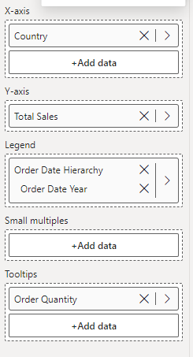
4 essential field wells in Column and Bar Charts:

Slide 35
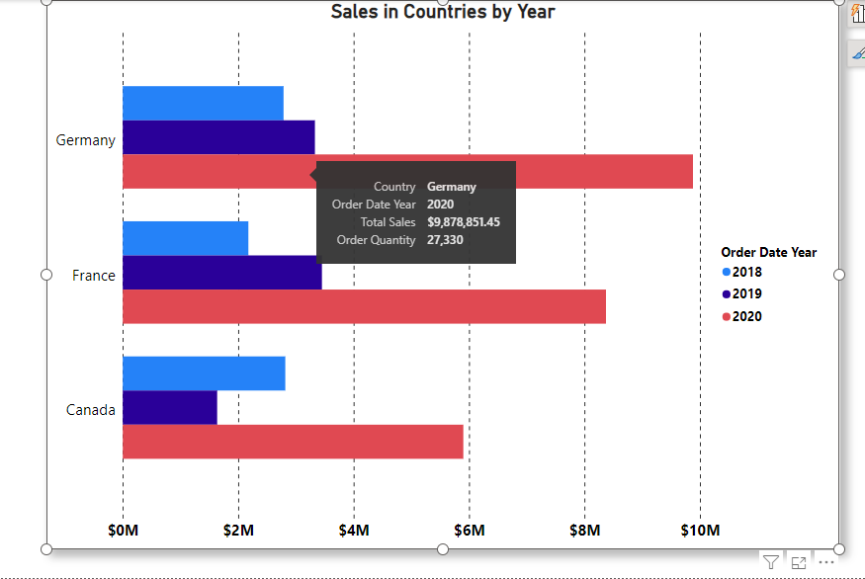
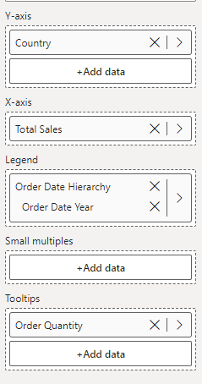
4 essential field wells in Column and Bar Charts:

Slide 36
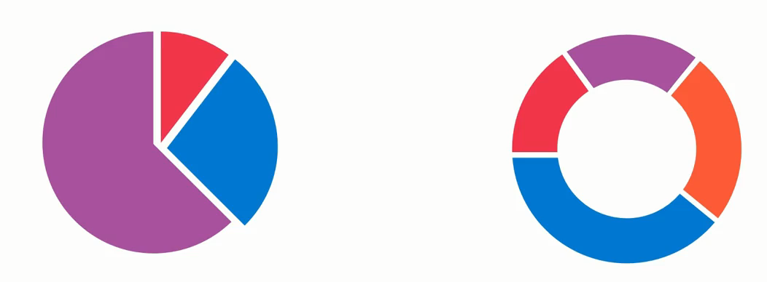
Pie and Donut Charts

Slide 37
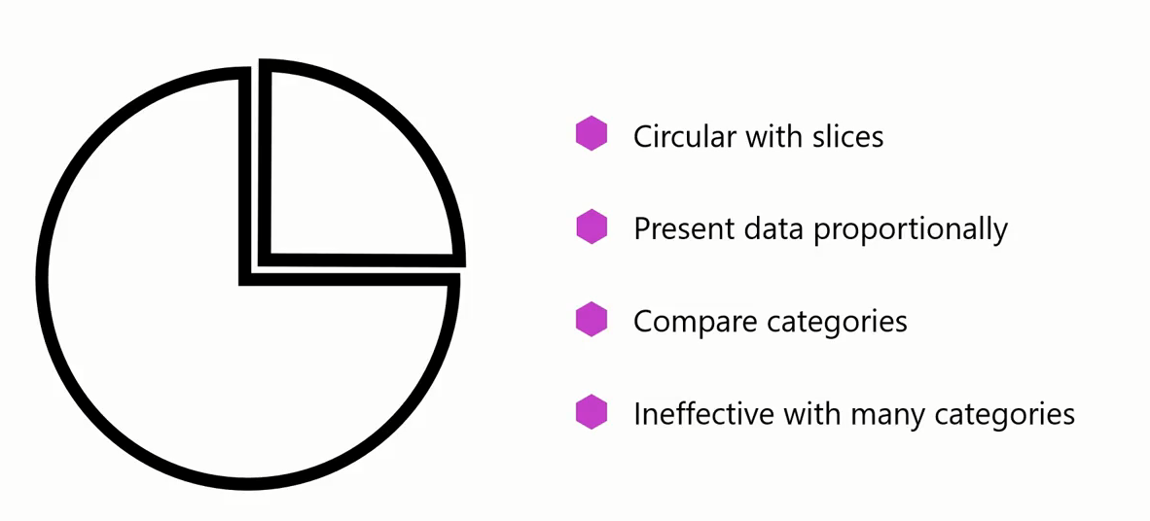
Pie and Donut Charts

Slide 38
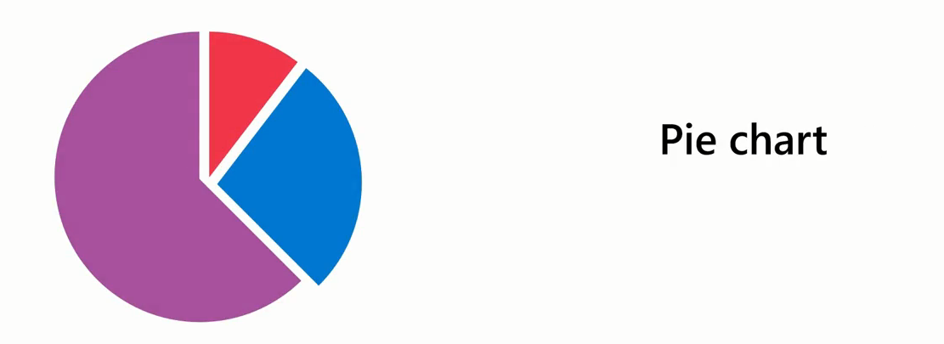
Pie and Donut Charts
In a pie chart, each slice of the pie corresponds to a unique category from your data set.
The size of each slice is directly proportional to the quantity it represents.

Slide 39
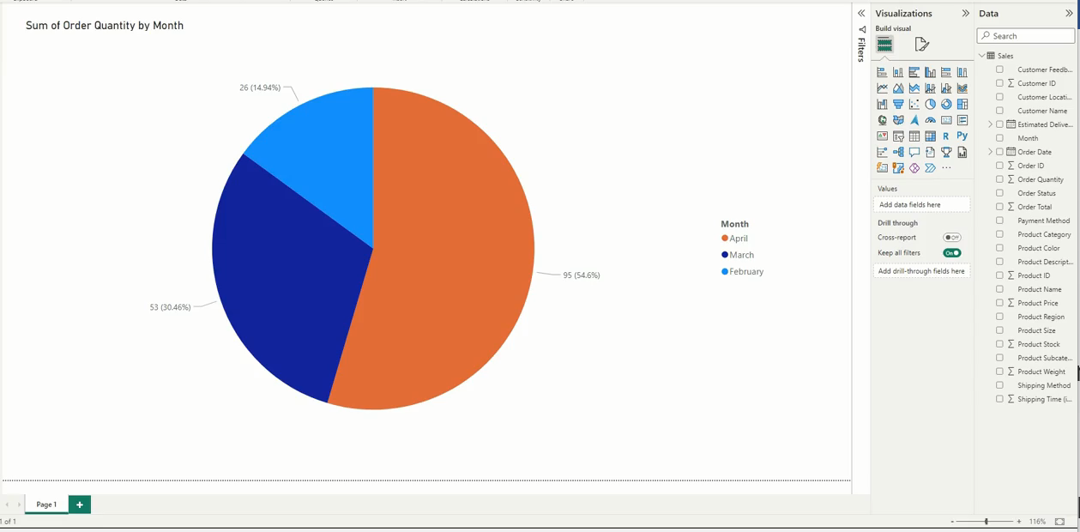
Pie and Donut Charts
Example: Sales in Months
The larger the slice the high sales in that month

Slide 40
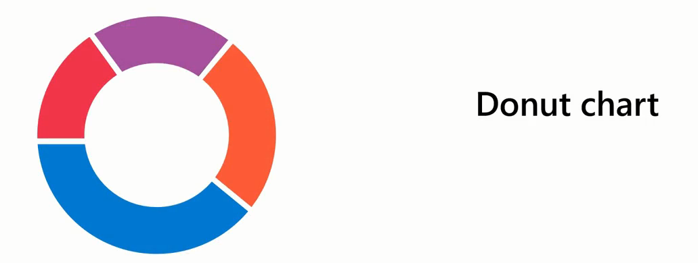
Pie and Donut Charts
The difference between a pie and a donut chart is that the donut chart is ring-shaped with a circular central space.
You can use this space to provide context for the surrounding segments.

Slide 41
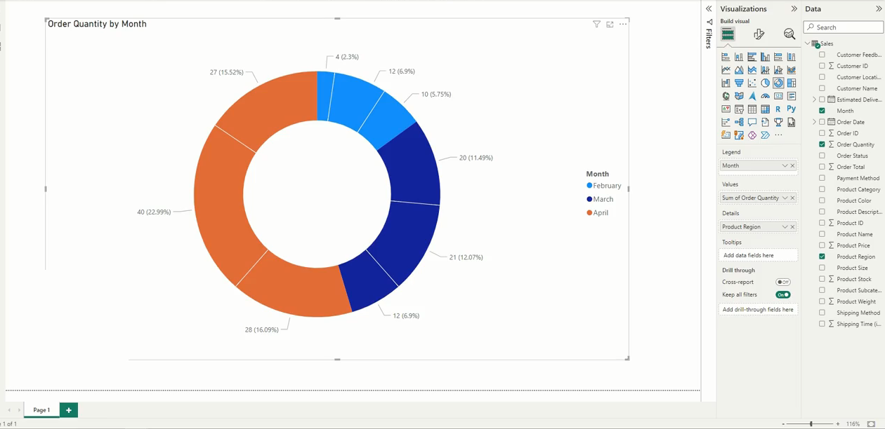
Pie and Donut Charts

Slide 42
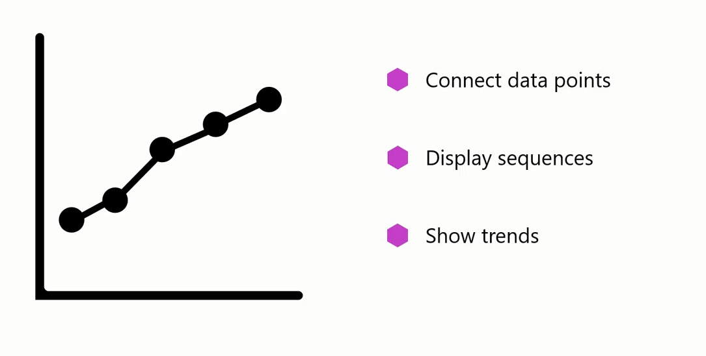
Line Chart

Slide 43
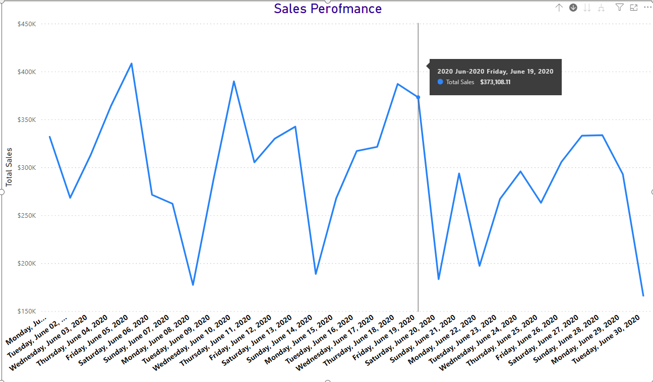
Line Chart
A line chart can help company understand how sales are progressing month to month or year to year.

Slide 44
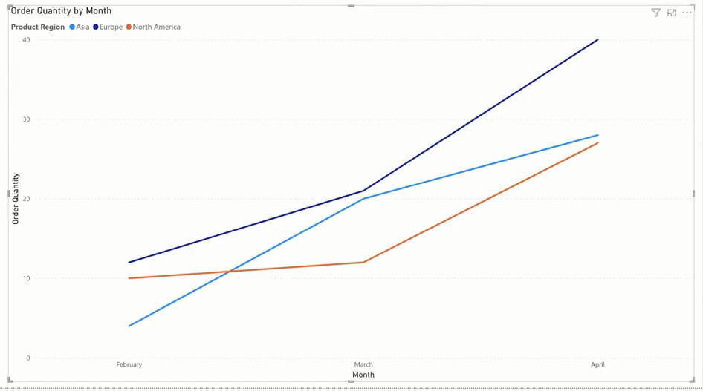
Line Chart
A line chart with multiple lines can show sales across different regions over time and help the stakeholders understand the trend or sales performance

Slide 45

Area Chart
While a line chart focuses on trends, an area chart emphasizes the magnitude of changes.

Slide 46
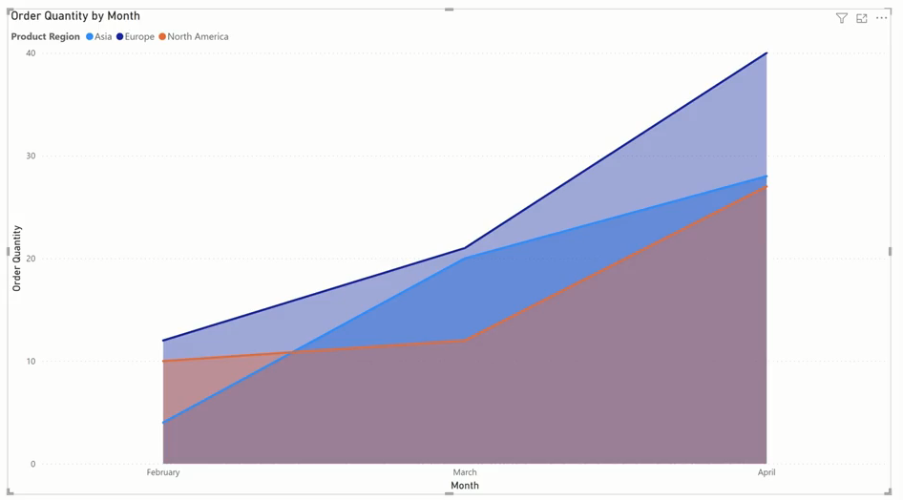
Area Chart
For example, regional sales represented by an area chart can help stakeholders intuitively understand and compare the degree each product region contributed to total sales for each month.

Slide 47
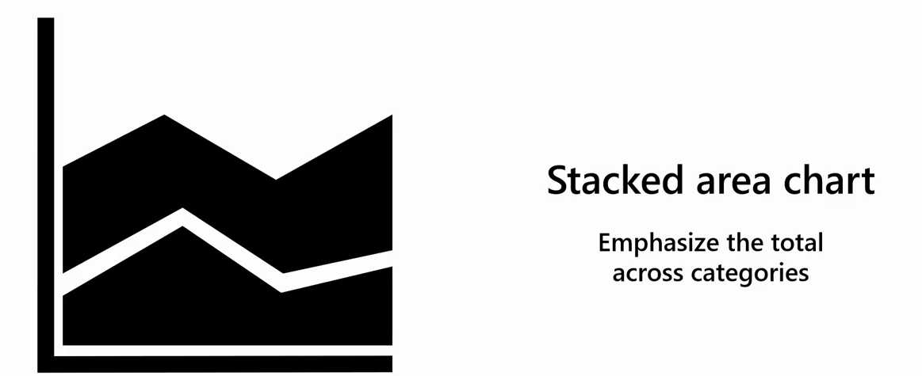
Area Chart
There's a variant of the area chart called a stacked area chart, where the data points from multiple categories are stacked on top of one another.

Slide 48
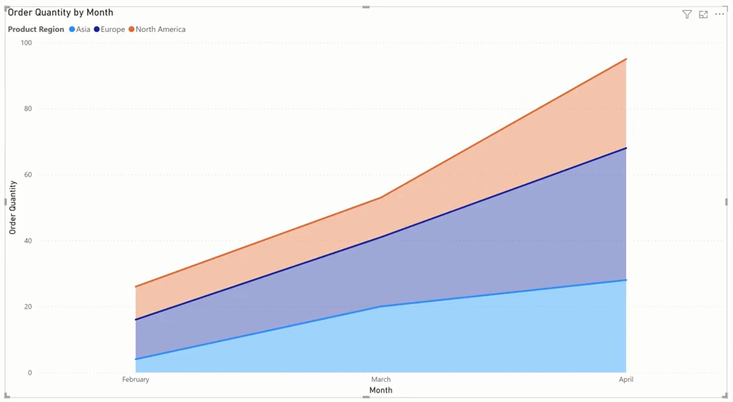
Area Chart
For example, you could use a stacked area chart to illustrate the total orders over a period and demonstrate how each product region contributes to the total.

Slide 49
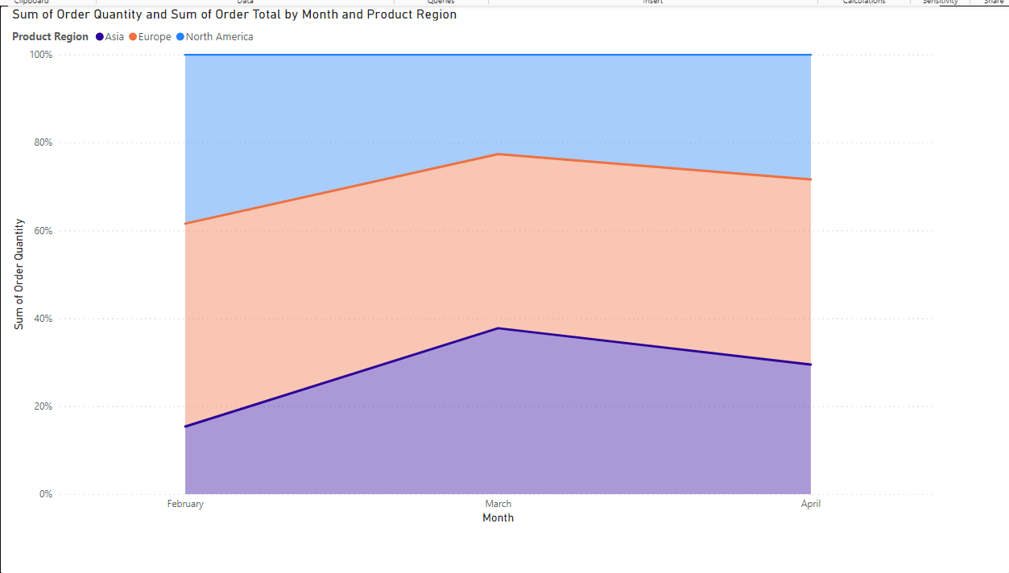
Area Chart
100% Stacked Area Chart

Slide 50
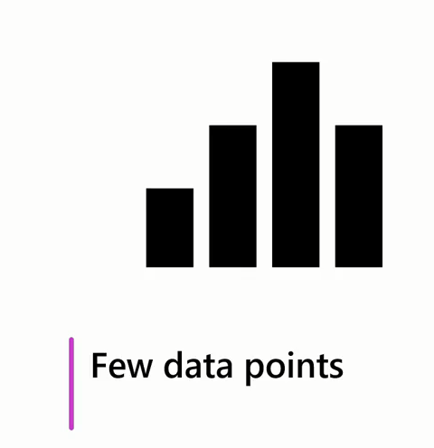
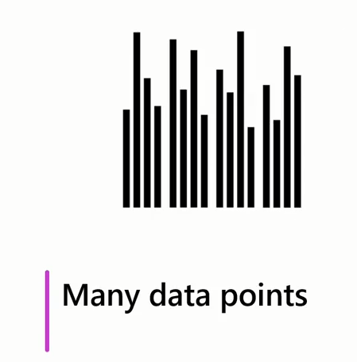
when to use bar and column charts, or line and area charts?
When presenting a few items, bar and column charts can be visually appealing and effective.
When dealing with many data points, these charts can become cluttered and difficult to read

Slide 51
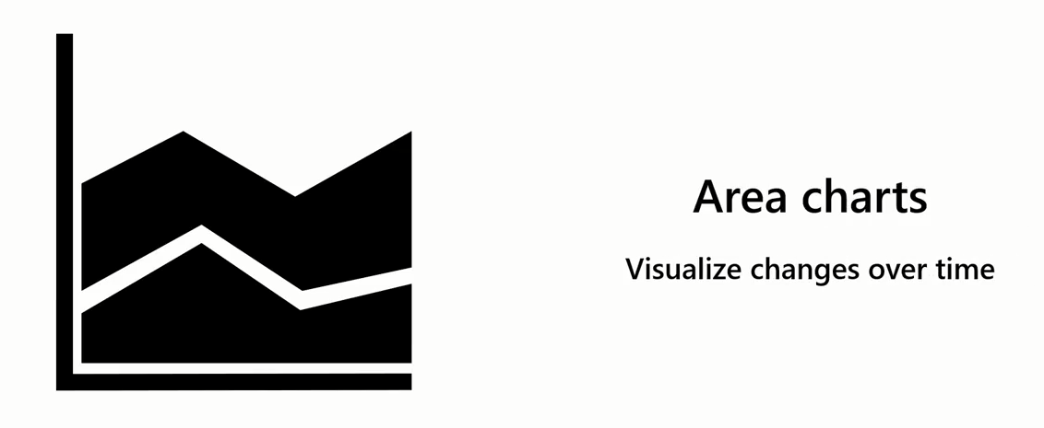
when to use bar and column charts, or line and area charts?
Area charts are effective for visualizing changes in multiple values over time.

Slide 52
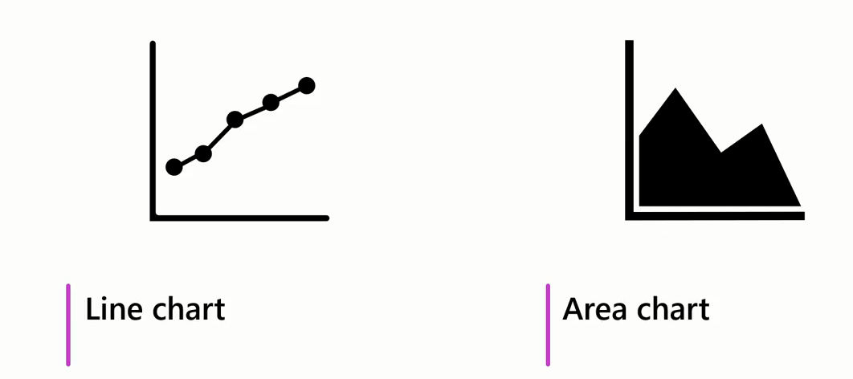
when to use bar and column charts, or line and area charts?
Both line and area charts are effective in visualizing the changes in values of multiple categories, particularly over time.

Slide 53
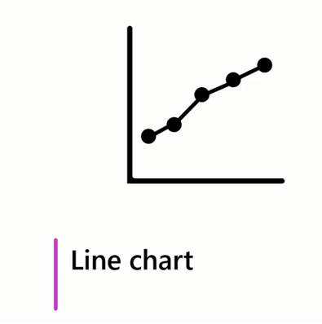
when to use bar and column charts, or line and area charts?
Line charts are useful for identifying trends

Slide 54

When to use bar and column charts, or line and area charts?
Area charts offer a further benefit:
Interpret the magnitude of the values.
Effectively illustrate the cumulative impact of the data points over the selected time,
Providing an overall picture of the data trends.

Slide 55

Table Visualization
Table visualization is useful when you want to employ the classic clear-cut style of tables to ensure your audience can grasp the essence of the data quickly.

Slide 56

Table Visualization
You can even customize the table visualization to improve its aesthetic appeal or aid engagement and comprehension.

Slide 57


Combo Chart
Sales in Regions Through months
Quantity Sold

Slide 58

Combo Chart

Slide 59

Combo Chart
A combo chart is a dynamic combination of a line and a column chart, allowing you to visually represent two different, yet interconnected data points.

Slide 60


Type of Combo Chart
A line and a stacked column chart
A line and a clustered column chart

Slide 61

Line and Stacked Column Chart

Slide 62


Line and Stacked Column Chart
How to Create

Slide 63

Line and Clustered Column Chart

Slide 64

Line and Clustered Column Chart
Example

Slide 65
Line and Clustered Column Chart
How to Create

Slide 66


Matrix
The matrix visual is similar to a table but has key features that allow the report designer to communicate multiple levels of information in the data.

Slide 67
Matrix
A table supports two dimensions, and the data is flat, meaning duplicate values are displayed and not aggregated. On the other hand, a matrix makes it easier to display data meaningfully across multiple dimensions because it supports a stepped layout.

Slide 68
Matrix
Unlike the table, the matrix automatically aggregates the data, enabling the viewer to drill down into the detail.

Slide 69

Matrix

Slide 70

Treemap
Treemaps are another helpful tool for illustrating your proportional data

Slide 71

Treemap
Instead of circles, treemaps use rectangles to display your data, making the best use of space in your reports and add variety by displaying data in new and exciting ways

Slide 72

Treemap
Add Variety.
Make full use of report space.

Slide 73

Treemap
Treemap is a visual used to display hierarchical data or data that's organized in a tree like structure as nested rectangles

Slide 74


Treemap
The entire chart represents the total dataset or tree.
Each rectangle or branch represents a portion of the whole tree

Slide 75


Treemap
Each rectangle size corresponds to the value or size of the data it represents

Slide 76

Treemap
Pie and donut charts can become cluttered and difficult to read when dealing with:
Many categories of variables, or
When the differences between data points are small.

Slide 77


Treemap
Example

Slide 78


Treemap

Slide 79


Funnel Chart

Slide 80

Funnel Chart

Slide 81

Funnel Chart

Slide 82


Funnel Chart

Slide 83



Funnel Chart
Expected Greater
Decline

Slide 84

Funnel Chart

Slide 85

Funnel Chart
Customer is interested
Customer is evaluated
Tailored solution for customer
Formal Proposal sent
Agree and Close the deal
Example

Slide 86

Ribbon Chart
A ribbon chart is a form of stacked chart for visualizing data and changes over time and has a clear ranking order.

Slide 87

Ribbon Chart

Slide 88

Ribbon Chart

Slide 89






Ribbon Chart

Slide 90


Ribbon Chart

Slide 91

Ribbon Chart

Slide 92

Waterfall Chart
Waterfall charts show a running total as Power BI adds and subtracts values.

Slide 93

Waterfall Chart
In data analysis and visualization, cumulative effects refer to how an initial value is affected by a series of positive or negative sequential factors, events, or changes over time.

Slide 94



Waterfall Chart
Example

Slide 95


Waterfall Chart

Slide 96

Waterfall Chart

Slide 97

Waterfall Chart
Unlike ribbon charts, Break Down field is optional in waterfall charts.

Slide 98

Scatter Chart

Slide 99

Scatter Chart

Slide 100


Scatter Chart

Slide 101


Scatter Chart

Slide 102







Scatter Chart

Slide 103
Scatter Chart
Scatter charts can help you identify:
trends,
patterns, and
anomalies like outliers in your data.

Slide 104
Scatter Chart
Anomalies refer to deviations from the general pattern of the data.

Slide 105

Scatter Chart
Outliers are a type of anomaly where valid data points significantly differ from other observations deviating from the general data trend.

Slide 106

Scatter Chart
Example
Revenue
Marketing Spent

Slide 107

Scatter Chart
Example
In this example, each dot shows one person's weight versus their height.

Slide 108

Scatter Chart
Example: An ice cream shop keeps track of each day's noon temperature and how much ice cream they sell that day. Here are data for 12 days:

Slide 109

Scatter Chart

Slide 110

Scatter Chart , Bubble and Dot ploy

Slide 111

Scatter Chart , Bubble and Dot ploy
To display the relationship between two numeric variables, you can create a scatter plot that defines the correlation between variables.

Slide 112

Scatter Chart , Bubble and Dot ploy
A variation of a scatter plot is a bubble chart that can display the relationship between three variables.
The third variable is represented in the size of a bubble.

Slide 113

Scatter Chart , Bubble and Dot ploy

Slide 114

Scatter Chart , Bubble and Dot ploy
Dot plot is one such visualization that is popular when presenting categorical data in relation to a numerical value.

Slide 115

Scatter Chart , Bubble and Dot ploy

Slide 116

Scatter Chart , Bubble and Dot ploy
Your Company needs insights into regional product category sales performance.
They need to know:
the quantity sold for each category and
the revenue per country.
Example

Slide 117

Scatter Chart , Bubble and Dot ploy

Slide 118


World Happiness Report
https://en.wikipedia.org/wiki/World_Happiness_Report

Slide 119
ANSWER 2
Which statements are true about dot plot chart? Select all that apply.
A. Dot plot chart is a variation of a scatter plot in Power BI.
B. Dot plot chart allows you to display relationship between two numerical data values.
C. Dot plot chart can be directly created from the visualization pane of Power BI desktop.
D. Dot plot chart enables you to plot categorical data on the horizontal axis of the chart.

Slide 120

Cards

Slide 121

Card Visual

Slide 122

Card Visual

Slide 123

Multi-row Card Visual

Slide 124

Radial gauge Visual
They take up a lot of space compared to the insights they provide.

Slide 125




Radial gauge Visual

Slide 126

KPI Visual

Slide 127


